Slide 1
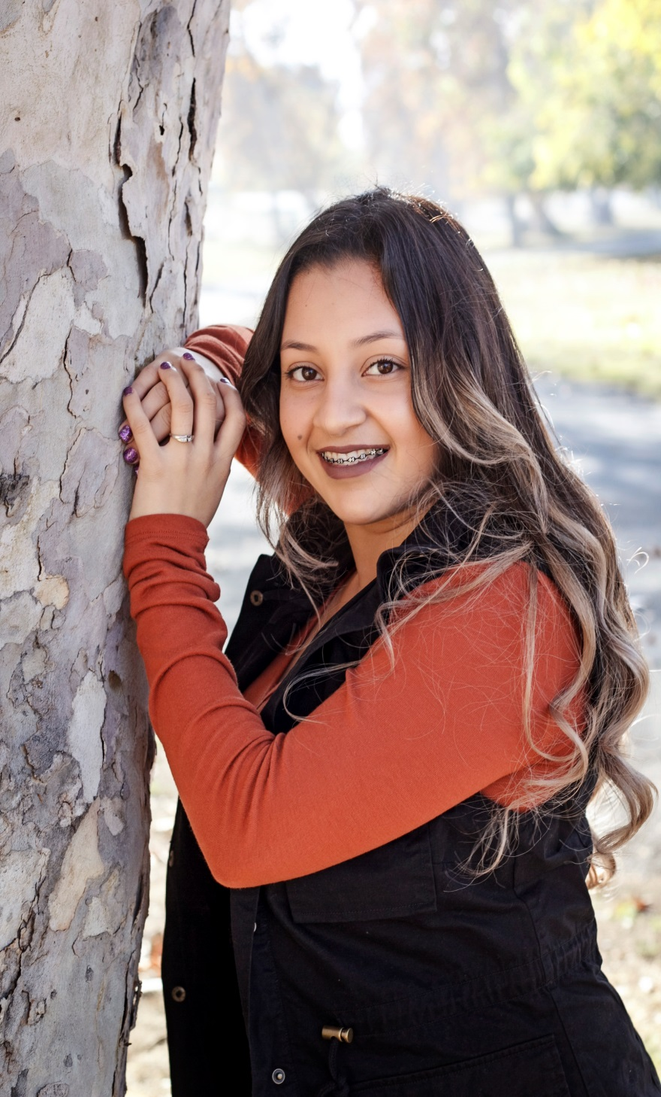
Jessica Espinoza

Slide 2
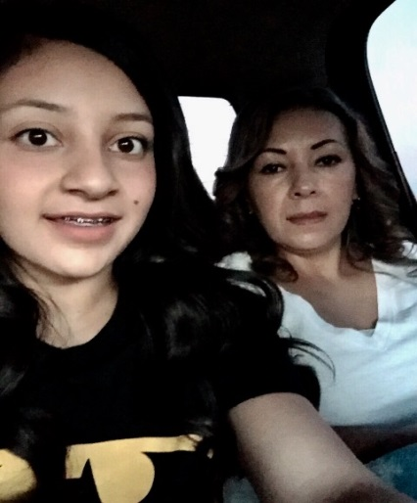
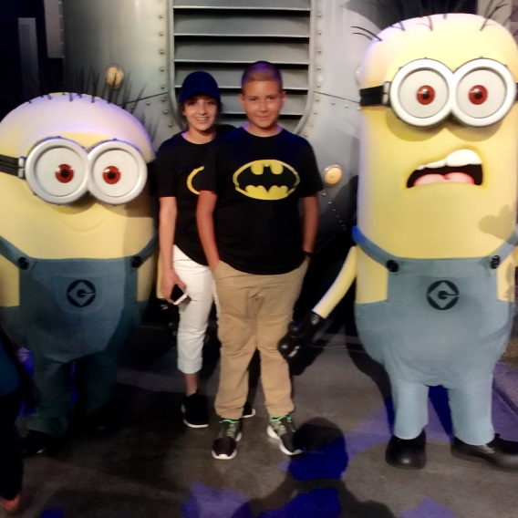
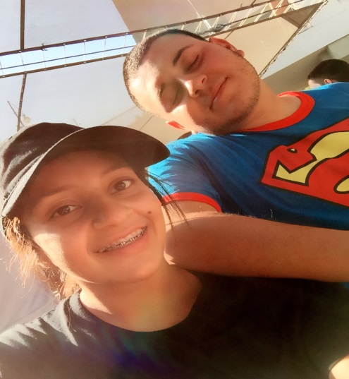
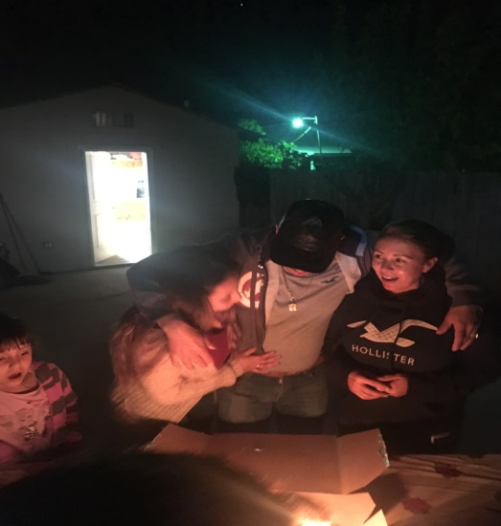
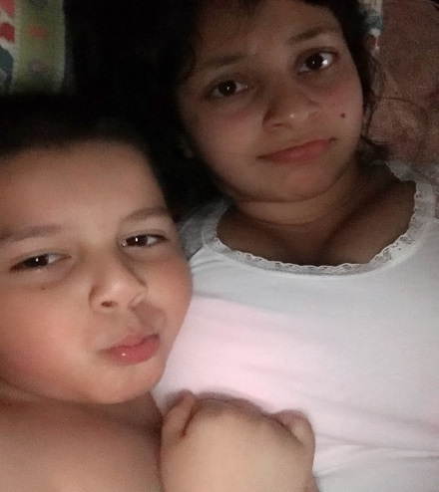
About Me!
I live with my parents
Only girl
3 brothers
My parents emigrated from Mexico their from Huatajo, Michoacán
Born and raised in Lindsay , Ca
Personal challenge
Striving for higher grades
I always wanted to settle for average

Slide 3
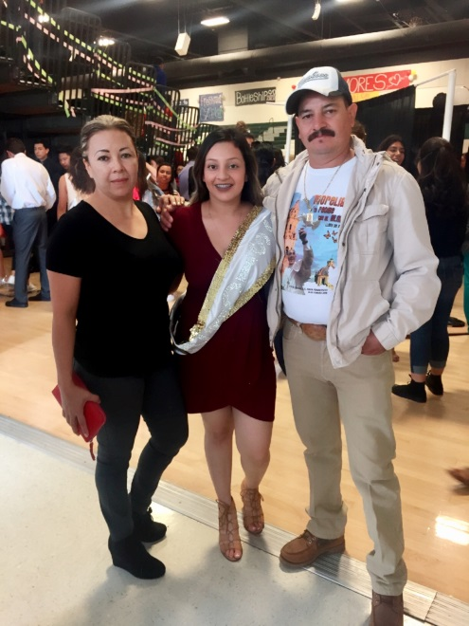
Challenges and Successes
A Challenge I faced with our PBS system
PROCASTINATION
Trouble meeting deadlines
A Success with PBS
Helped me be more organized
Schedule
As a student
My motivation are my parents
They want to see I will be successful

Slide 4
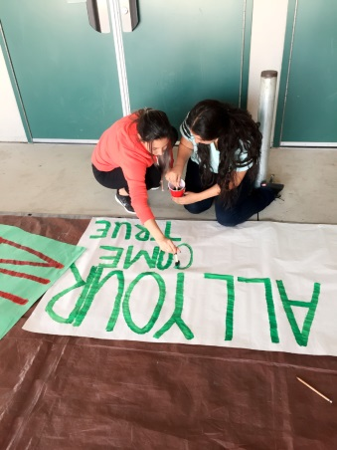
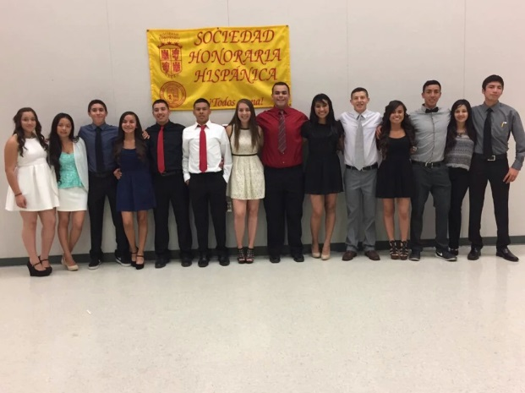
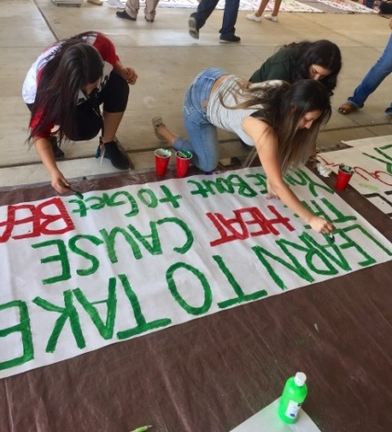
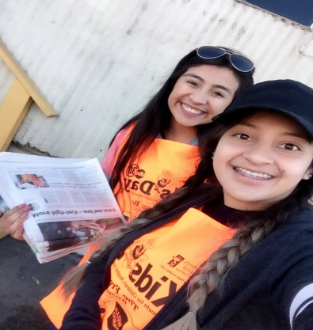
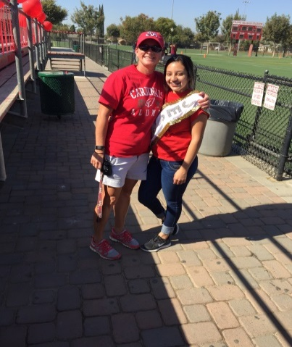
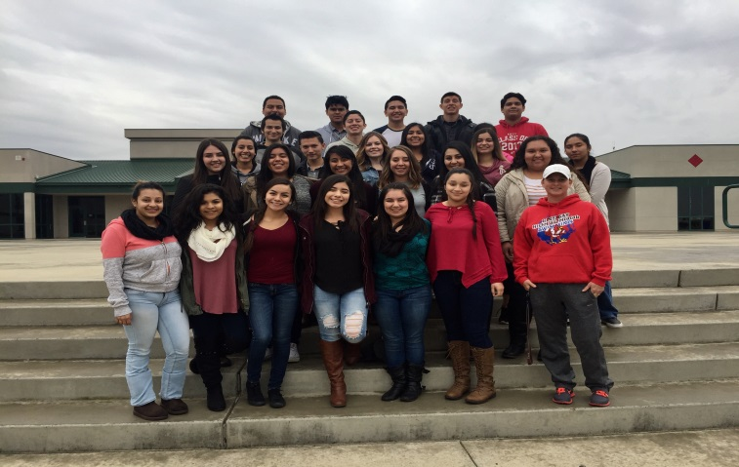
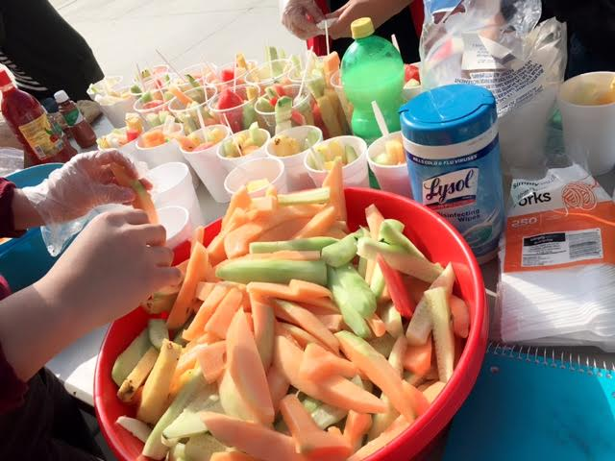
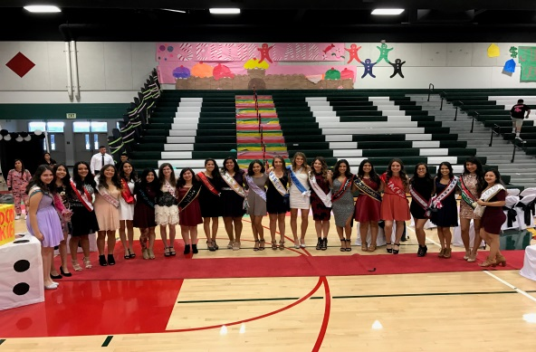
My High School Experiences
Clubs
ASB
planning school events, and participating out of school
National Spanish Honor Society
Honors club 3.5 GPA
My Voice
Teen dating violence awareness
Fruit
AVID
Homecoming

Slide 5
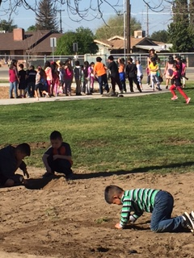
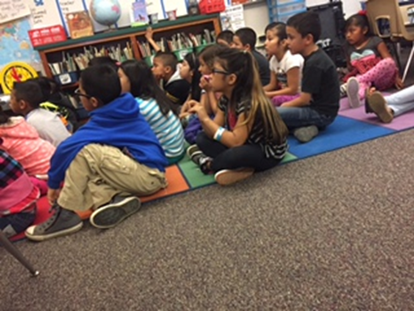
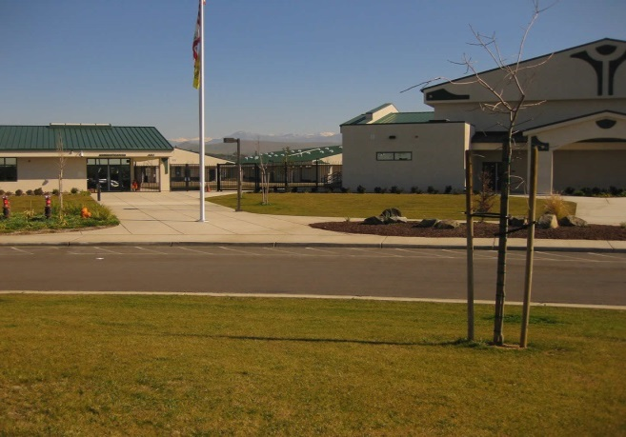
Job Shadow
Mrs. Diaz a 7th grade teacher at Roosevelt Elementary
Interesting and caught my attention
Focused kids
Will always remember from Mrs. Diaz…
Mange's her class amazingly
Full respect

Slide 6
Pathway
Spanish
Elementary bilingual teacher
As student it has built me with stronger vocabulary in Spanish
stronger writing in Spanish
speak it in an educated way

Slide 7
After High School Plans
Porterville College
Financials
General Ed
I applied to…
Fresno State (accepted) (transfer)
Sacramento State(conditionally accepted)
California State University Monterey(accepted)

Slide 8
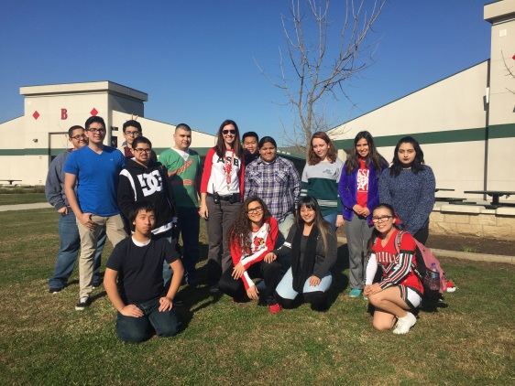
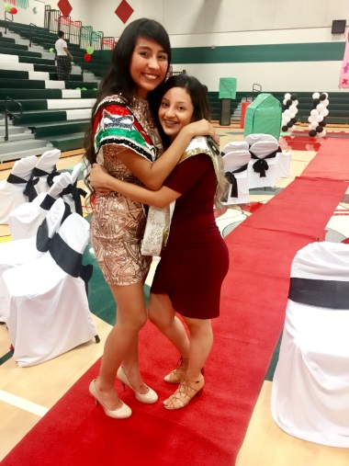
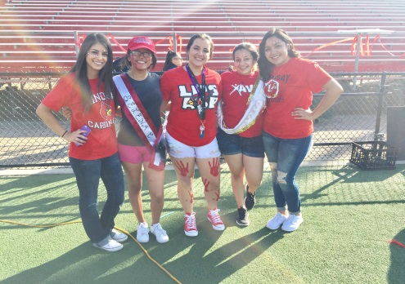
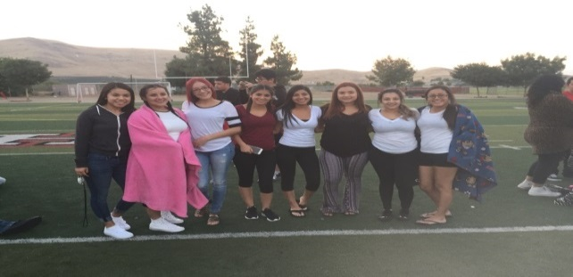
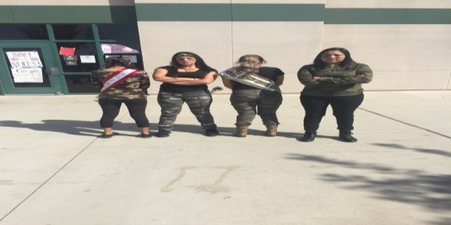
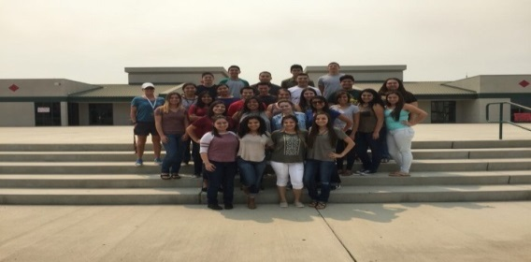
Leaving High School
I got to say bye to my second grade teacher (Forbus)
Mr. Guss, Mrs. Zike (influential teachers)
Pushed me to do level 4s
“At the end of the day, their the ones who put in the grade”
Mrs. Zike has supported me she’s had my back
In anything I want to do she always tells me “You could do it”
The PBS system has taught to be independent throughout my 4 years of high school
We work at our own pace
It prepares me because in college I wont have teachers reminding me deadlines

Slide 9
Thank you for attention…
Any Questions?

